Slide 1
Artificial Intelligence Design for ship structure :
A variant Multiple-Input Neural Network-based ship Resistance prediction
2022.07.12
Journal of Mechanical Design (2022)
Yu Ao, Yunbo Li, Jiaye Gong, Shaofan Li¹
College of shipbuilding Engineering, Harbin Engineering Univ
College of Ocean Science and Engineering, Shanghai Maritime University
Department of Civil and Environmental Engineering, University of California, Berkely
Notes:
플랫폼을 replacement 하는 시간을 결정하는 문제.
강창묵 교수님의 논문을 많이 reference한 논문인데, 최근 논문이라 가져와봤습니다.

Slide 2
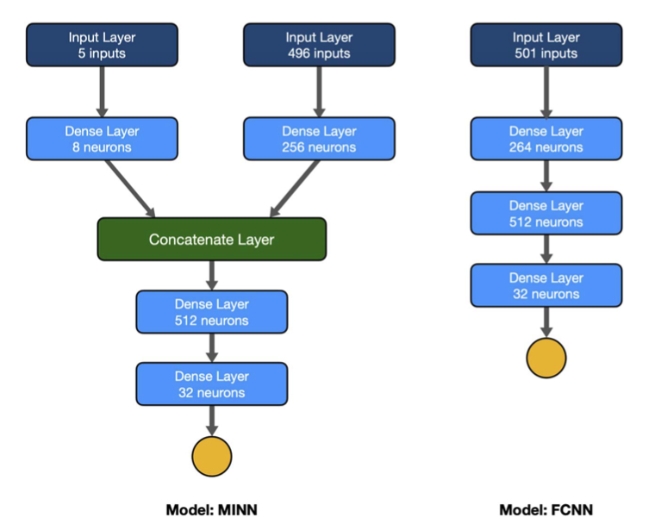
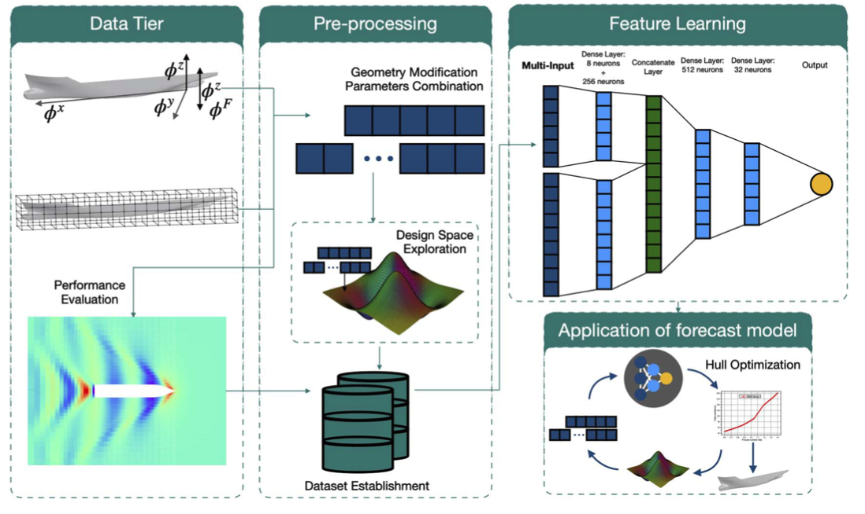
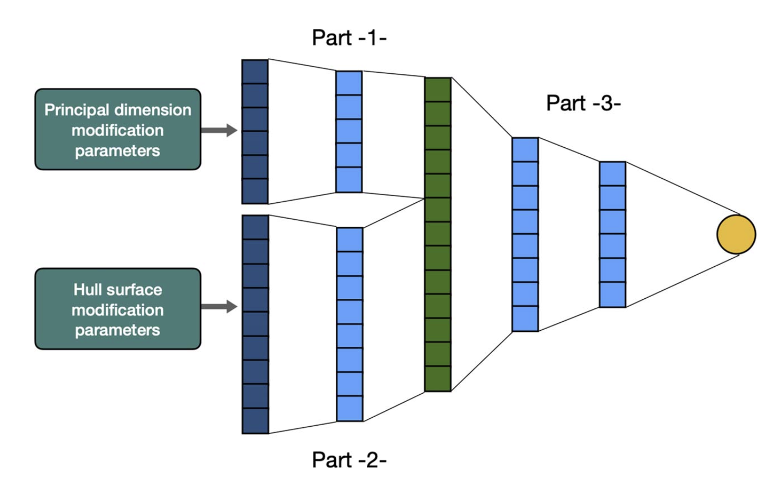
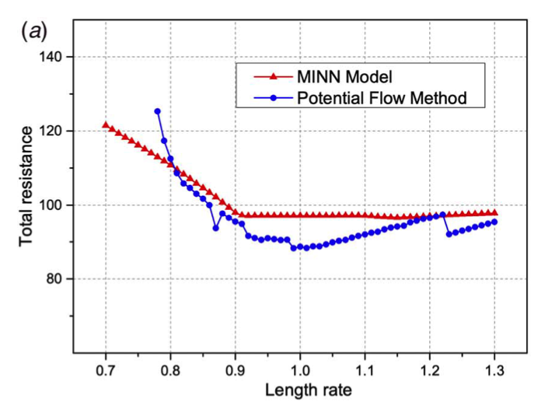
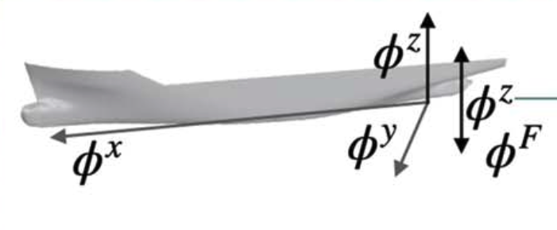
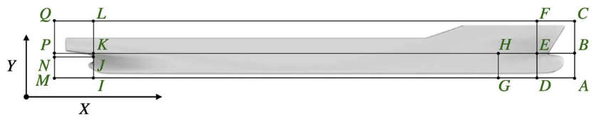
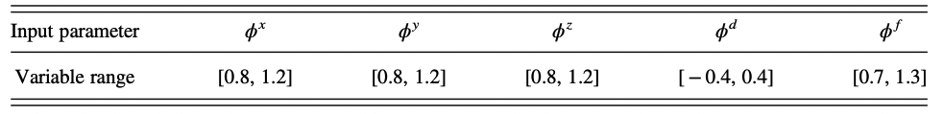
Multiple-Input Neural Network-based ship Resistance prediction
Overall Flow
(2)
Multi Input Neural Network
(3)
Output
(1)
1) Principal dimension parameter
2) Hull surface parameter
Notes:
Frictional resistance & wave_making resistance

Slide 3
Development of a Conditional Generative Adversarial Network for Airfoil Shape Optimization
2022.07.12
Journal of Mechanical Design (2022)
Gabriel Achour, Woong Je Sung, Olivia J. Pinon, and Dimitri N. Mavris
School of Aerospace Engineering Georgia Institute of Technology, Atlanta, Georgia
Notes:
플랫폼을 replacement 하는 시간을 결정하는 문제.
강창묵 교수님의 논문을 많이 reference한 논문인데, 최근 논문이라 가져와봤습니다.

Slide 4
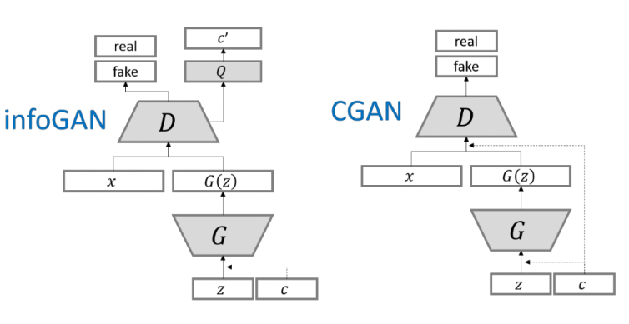
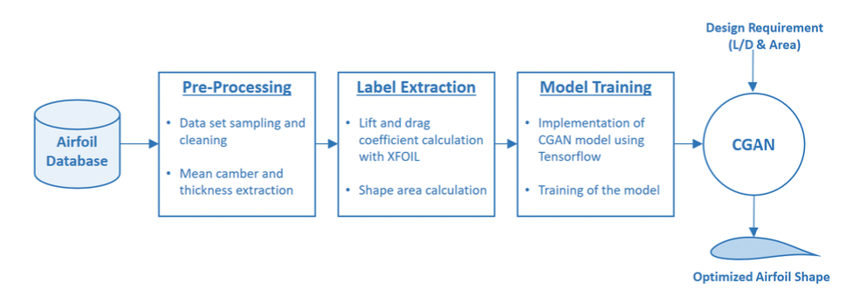
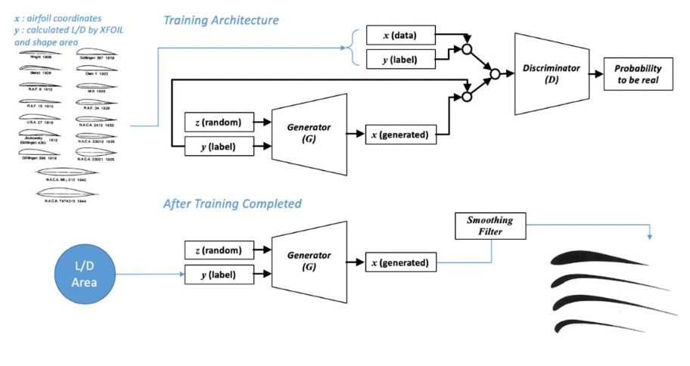
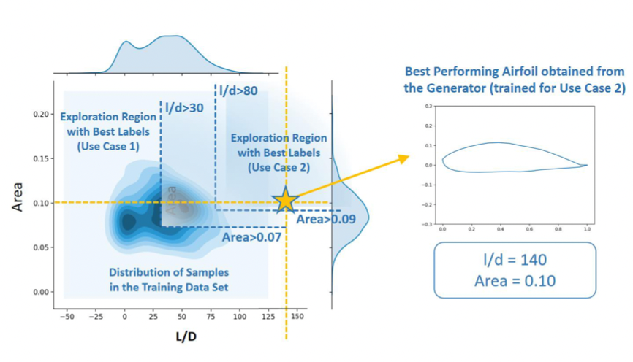
Development of a Conditional Generative Adversarial Network for Airfoil Shape Optimization
Conditional GAN architecture
Graph of Area & L/d and new optimal design
Meaningful
1) 생성자 모델을 활용함으로써, 데이터 부족 현상 해결
2) 기존엔 GAN을 활용해 생성하는 것 따로, design spec 따로 ➔ CGAN을 활용해 두개를 한번에
Limitation
1) 단순화된 구조
- requirement가 오직 2개
- 생성하는 모형이 단순 2D 상의 airfoil)

